Slide 1


Welcome

Slide 2

Teacher’s Indrotuce
Md Tajul Islam
Assistant teacher
Chrinow Govt. Primary School
Habigonj Sador,
Hobigonj.

Slide 3

Lesson Identity
Class-One
Unit-5
Lesson-5
Kring kring telephone
(First three lines)
Time- 40 minutes.

Slide 4
Do you like to
see a picture?
Let’s see.

Slide 5
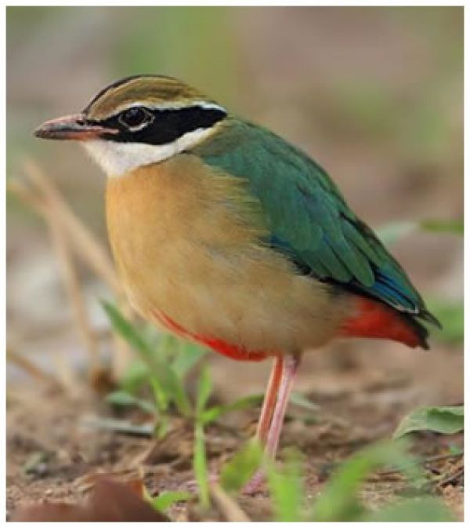

Slide 6
Learning outcomes
4.1.1. Enjoy the
rhythm and music
of simple rhymes.

Slide 7

Kring kring telephone

Slide 8
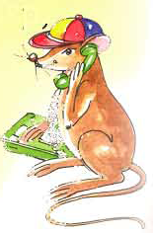
Hello hello!

Slide 9
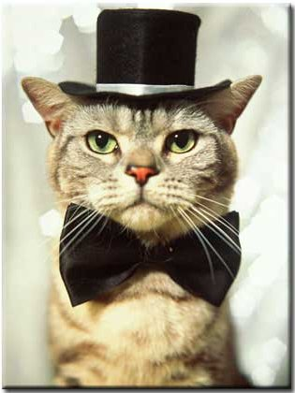
I am a cat in a hat.

Slide 10
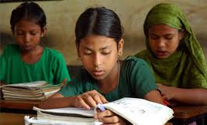
Open your book and look at the lesson
Page no-59
Lesson-5

Slide 11
Are you want to listen the rhyme?
Keep quite and listen the rhyme.
Kring kring telephone
Hello hello!
I am a cat in a hat.

Slide 12
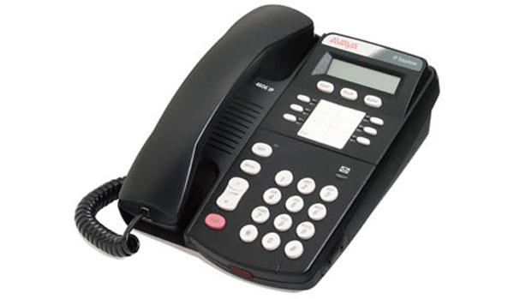
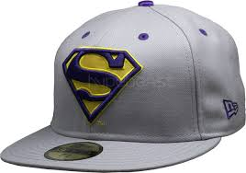
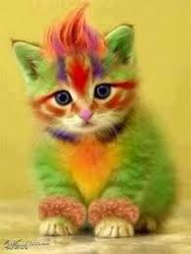
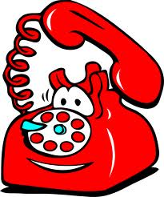
Group work
Think about the picture and tell the names of the word.
Group-B
Group-A

Slide 13
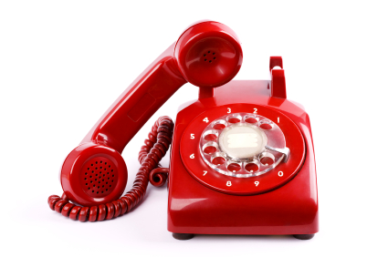
Checking learning
Recite the rhyme with correct pronunciation
Kring kring telephone
Hello hello!
I am a cat in a hat.

Slide 14
New word
T Telephone
H Hat
K Kring

Slide 15


Thanks to all.

